Slide 1
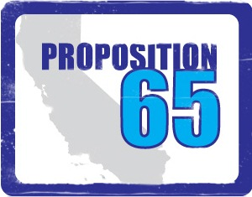
CAL PROP 65
and
Other State Regulations

Slide 2
This information is being furnished by PPAI for educational and informational purposes only. The Association makes no warranties or representations about specific dates, coverage or application.
Consult with appropriate legal counsel about the specific application of the law to your business and products.

Slide 3
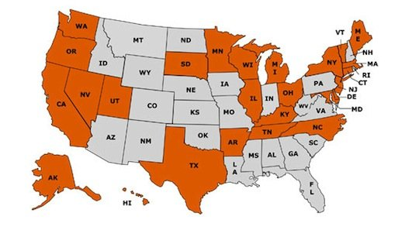
Many states are passing new chemical regulations. Why?

Slide 4
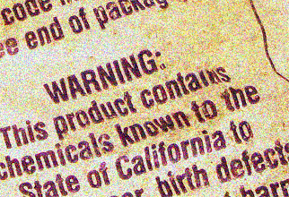

California
Cal Prop 65
The Safe Drinking Water and Toxic Enforcement Act of 1986
Safer Consumer Products Legislation (Green Chemistry Initiatives) (2013)

Slide 5
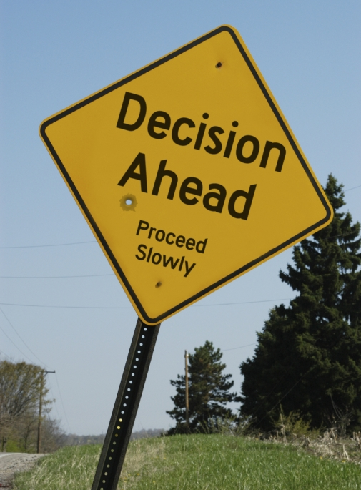
Cal Prop 65
The Basics
No Pre-emption
Purpose is to give consumers a chance to make an “informed decision” to protect them from exposure to chemicals.

Slide 6
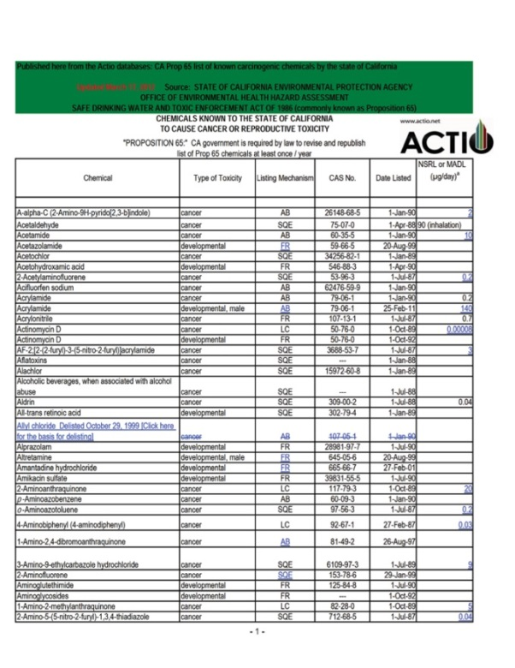
Cal Prop 65
The Basics
No Pre-emption
California’s Office of Environmental Health Hazard Assessment (OEHHA ) must annually publish a list of chemicals known to cause cancer, birth defects or other reproductive harm.
List is approx. 900 chemicals now.

Slide 7

Cal Prop 65
The Basics
No Pre-emption
Once a chemical is listed by OEHHA, companies have 12 months to comply with warning requirements under the regulation

Slide 8
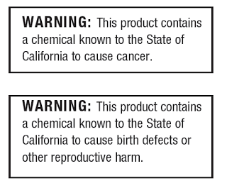
Cal Prop 65
The Basics
No Pre-emption
Provide a “Clear and Reasonable Warning” before knowingly and intentionally exposing anyone to a listed chemical

Slide 9
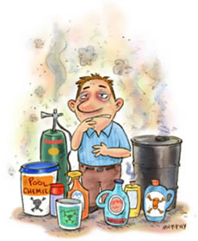


Prop 65 is an “exposure” regulation
Methods of Exposure:
Oral
Inhalation
Transdermal
Hand-to-mouth
Measuring Exposure:
In most cases, exposure is measured in micrograms per day, based on average use of the product. Very difficult and expensive to defend a claim, since burden is on maker.
Recent Lead and Phthalate Cases:
Newer cases involving lead and phthalates have mirrored CPSIA content limits

Slide 10
<iframe width="560" height="315" src="//www.youtube.com/embed/MgMyV7QwKYU" frameborder="0" allowfullscreen></iframe>

Slide 11

Exemptions under Cal Prop 65
If your company has less than 10 employees (including part-time), it is exempt from warning requirements; recent amendment clarified this to apply to non-California companies too

Slide 12
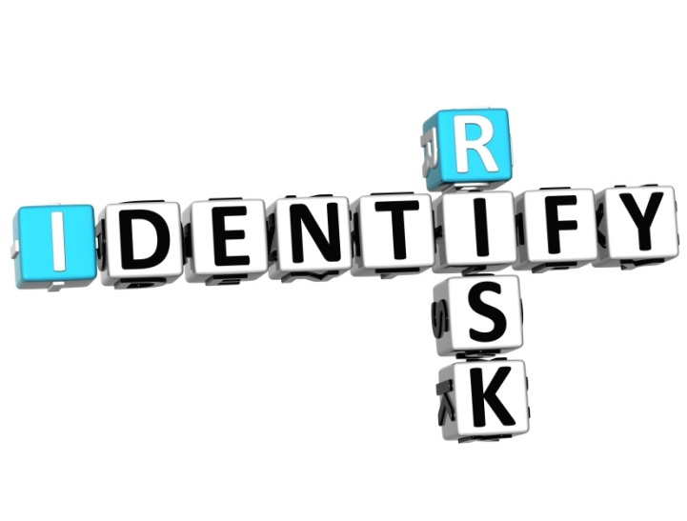
Exemptions under Cal Prop 65
Safe harbor levels have been established for many Prop 65 listed chemicals. Exempt if:
No Significant Risk Levels (NSRLs) for cancer-causing chemicals; and
Maximum Allowable Dose Levels (MADLs) for chemicals causing reproductive toxicity are not exceeded

Slide 13
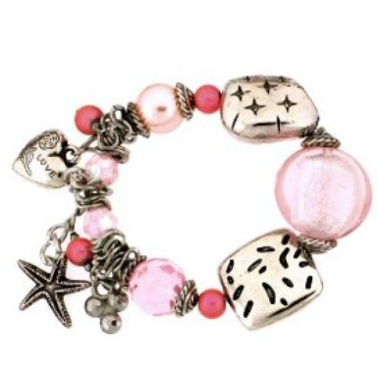

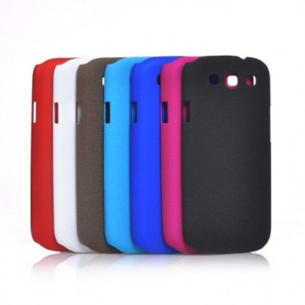
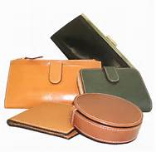
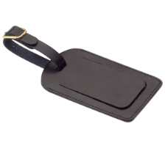
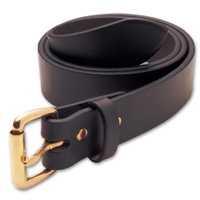
California Proposition 65
Frequently Targeted Products
Jewelry for adults and children (lead and cadmium)
Decorated glass and ceramic drinkware (lead and cadmium)
Padfolios, desk accessories, checkbook covers, phone covers, luggage tags (lead and phthalates)
Leather goods, belts, wallets, footwear, eyeglass cases (lead)

Slide 14


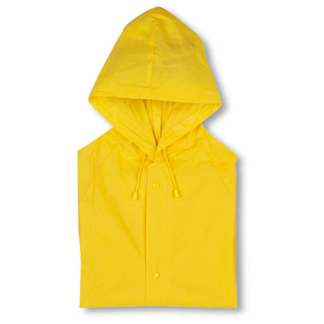

California Proposition 65
Frequently Targeted Products
Sporting goods and children’s toys (lead and phthalates)
Electronics and electrical cords (lead, cadmium, phthalates)
Tableware, picnic products, distilled spirits, wine, beer (lead, phthalates, sulfites)
Plastic items, especially those made with PVC (phthalates)

Slide 15


Enforcement of Prop 65
State Attorney General’s Office enforces Prop 65; District Attorneys and City Attorneys can too
Private Enforcers: any individual may bring an action to enforce.
Very prolific; vast majority of claims

Slide 16

Enforcement of Prop 65
Violations can be up to $2,500/day per violation; private enforcers can enter into settlements and split $$ with State; the court approves and enters judgment against business owner.

Slide 17
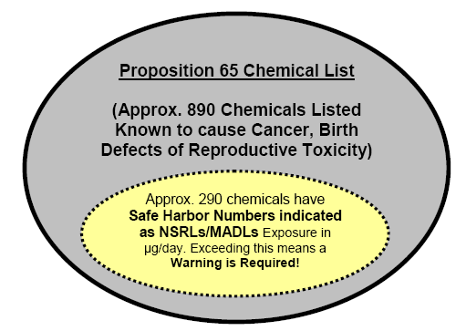

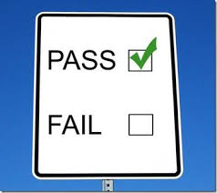
What Can We Do to Comply?
Check Chemical List published and updated by the Office of Environmental Health and Hazard Assessment (OEHHA), and can be found at www.oehha.ca.gov
Confirm with Suppliers:
Confirm with supplier or manufacture that none of the chemicals have been intentionally added.
Test and Comply with Prop 65 Settlements:
Ask your customer if the product may be distributed in CA;
Ask for test reports;
Have products tested for “usual suspects”;
Apply warning label.

Slide 18
California Proposition 65
What’s Next
Potential amendments to Article 6 Clear and Reasonable Warnings
Listing of new chemicals in 2014
        Ethylene Glycol
        N, N-Dimethyl-p-Toluidine
        Pentosan polysulfate sodium
        Pioglitazone
        Triamterene
        Pulegone
        Emissions from High-Temperature Unrefined Rapeseed Oil
        Methyl isobutyl ketone (MIBK)
        Megestrol acetate
        Trichloroethylene

Slide 19

Wait…there’s more from California
On 8/28/13, the California Dept. of Toxic Substances Control approved the “Safer Consumer Product Regulation”:
Intent is to protect public health and/or environment;
Took effect on 10/1/13 and will be phased in over several years;
Establishes a process to identify consumer products and chemicals of concern;
Approx. 1200 chemicals in total may be identified; ~164 initial candidate chemicals
  Is the chemical necessary?
  Is there a safer alternative?

Slide 20
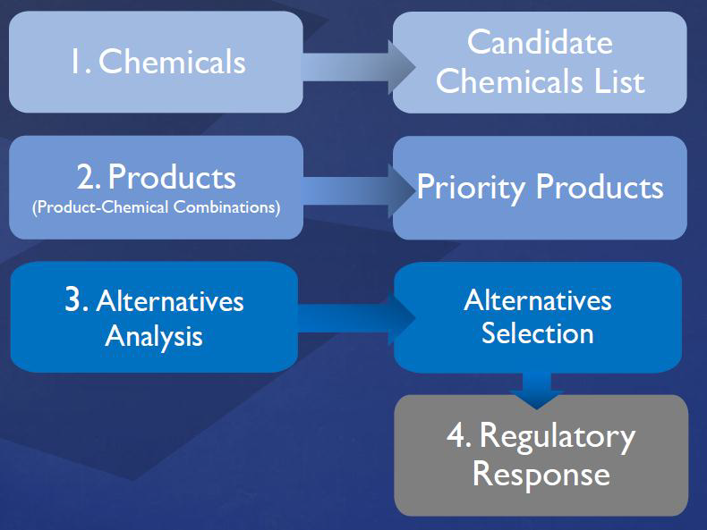
California Safer Consumer Product Regulations
4 Step Process

Slide 21
Wait…there’s more from California
Designated 3 priority products and chemicals for assessment of safer alternatives
  Children’s foam padded sleeping products containing the flame retardant TDCPP, also known as chlorinated tris
  Paint and varnish strippers and surface cleaners with methylene chloride
  Spray polyurethane foam (SPF) systems containing unreacted diisocyanates (insulation)
Will require alternative assessments for Priority Products/Chemical combinations
Will impose conditions for compliance (i.e., warnings, notices, restrictions or bans on use of chemicals or products.

Slide 22
California Safer Consumer Products Regulations
In September, the DTSC proposed a 3 year work plan with the following product categories:
  Beauty, Personal Care and Hygiene Products
  Building Products (Adhesives, Paints, Sealants, etc.)
  Household, Office Furniture and Furnishings
  Cleaning Products
  Clothing
  Fishing and Angling Equipment
  Office Machinery (i.e. ink cartridges)

Slide 23
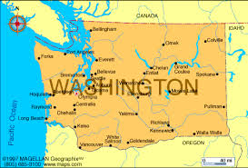

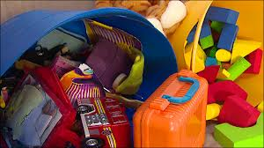
WASHINGTON STATE CHILDREN’S SAFE PRODUCTS ACT
On to the State of Washington!
“Chemicals of High Concern” to Children
State is developing a list of chemicals that manufacturers must report on; 66 CHCC’s have been listed to-date;
CHCC’s include: BPA, phthalates, formaldehyde, mercury, cadmium, etc.;
Children’s Product “Tiers” classification method, depending on “mouthable” or contact with skin or mouth aspects of the product;
Manufacturers must report to WA State if their products contain any CHCC’s if exceed an established concentration limit (if intentionally added) or 100ppm if classified as a trace “contaminant” that is incidental to manufacturing.

Slide 24
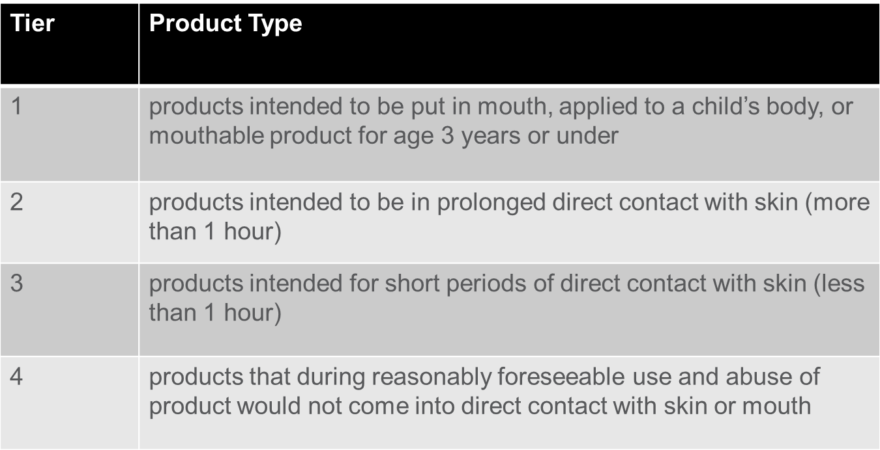
Washington State Children’s Safe Products Act Reporting
Reporting is based on two factors:
    Size of the manufacturer
    Tier of children’s product

Slide 25
Washington State Children’s Safe Products Act
Reporting Schedule
Manufacturer Categories | Product Tier 1 | Product Tier 2 | Product Tier 3 | Product Tier 4
Largest Annual sales > $1 Billion | 8/31/12 | 2/28/13 | 8/31/13 | case-by-case
Larger Annual sales $250M to <$1B | 2/28/13 | 8/31/13 | 8/31/14 | case-by-case
Medium Annual sales $100M to <$250M | 8/31/13 | 8/31/14 | 8/31/15 | case-by-case
Small Annual sales $5M to <$100M | 8/31/14 | 8/31/15 | 8/31/16 | case-by-case
Smaller Annual sales $100K to <$5M | 8/31/15 | 8/31/16 | 8/31/17 | case-by-case
Tiny Annual sales< $100K | 8/31/16 | 8/31/17 | 8/31/18 | case-by-case

Slide 26
Washington State Children’s Safe Products Act
Best Practices
Test for all 66 chemicals in all materials
    Costly
    Unnecessary
Research-based approach
    Identify where chemicals may be found
    Classify whether chemical is intentionally added, contaminant or not used
    Perform reduced testing, as needed, to determine reporting obligation

Slide 27
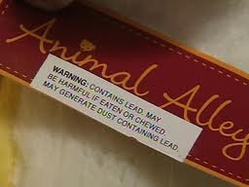
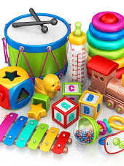
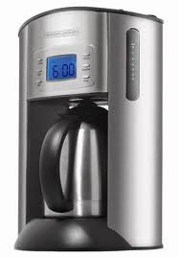
Illinois Lead Poisoning Prevention Act
Products or packaging must have a warning label if:
  Toys, child care articles (6 yrs. and under) and children’s jewelry (12 yrs. and under) if lead in surface coatings is greater than 40ppm;
  Child care articles and children’s jewelry if lead in substrate is >40 ppm
  Products for adults if lead in surface coatings or substrate is greater than 600ppm.

Slide 28
Maine’s Toxic Chemicals in Children’s Product Law
Overview
Maine has designated five chemicals as priority:
    Bisphenol A (BPA)
    Nonylphenol/Nonylphenol Ethoxylates (NP/NPE).
    Cadmium
    Mercury
    Arsenic
Manufacturers using these chemicals in certain product categories are required to report to Maine DEP when used in an amount greater than the de minimis.
Manufacturers must report by the deadline specified; however, if you are a manufacturer introducing a product that was not offered for sale at that time, you must file the applicable report with the Department within 30 days of the product being offered for sale in Maine.
One time reporting requirement

Slide 29
Maine’s Toxic Chemicals in Children’s Product Law
Chemicals
BPA – Prohibits the sale of reusable food and beverage containers made with BPA;
Prohibits the sale of baby food packaging and infant formula packaging made with BPA;
Requires manufacturers using BPA in toys, child care articles, and tableware to file a report
with the Department.
NP/NPE – Requires manufacturers using NP/NPE in household and commercial cleaning
products, cosmetics and personal care products, and home maintenance products to file a
report with the Department.
Cadmium/Mercury/Arsenic – Requires manufacturers using cadmium, mercury, or
arsenic in Bedding, Childcare Articles, Clothing, Cosmetics, Craft Supplies, Footwear,
Games, Jewelry and Embellishments, Safety Seat, Occasion Supplies,
Personal Accessories, Personal Care Product, School Supplies, Toys to file a
report with the Department.

Slide 30
Maine’s Toxic Chemicals in Children’s Product Law
Reporting
Manufacturers are now required to report to the Maine DEP the use of cadmium, arsenic, and mercury in certain categories of children’s products which are sold in the State of Maine.
Reports must be submitted to Maine DEP no later than November 28, 2014.
Bedding, Childcare Articles, Clothing, Cosmetics, Craft Supplies, Footwear, Games, Jewelry and Embellishments, Safety Seat, Occasion Supplies, Personal Accessories, Personal Care Products, School Supplies, Toys

Slide 31
Vermont SB.239 – An Act Relating to the
Regulation of Toxic Substances
Applies children’s products (under 12 years of age)
Effective June 10, 2014
List of 66 CHCC’s - same as Washington State’s CSPA List
PQL and analytical test method to be provided
Domestic manufacturers, private labeler and/or importer of record are responsible for reporting
CHCC Disclosure Notices are due July 1, 2016
A Fine of $200 per notification will be applied.

Slide 32
Other States Regulating Chemicals of Concern
States with bans on certain flame retardants:
TRIS, TDCPP, TDCP, TCEP,TCPP, PBDEs, decaBDE, and others
Found mainly in children’s clothing and furniture due to potential cancer risk through skin absorption or mouthing
Connecticut, Delaware, Illinois, Massachusetts, Maryland, Maine, Missouri, North Carolina, New Jersey, New York, Oregon, Vermont, Washington…

Slide 33
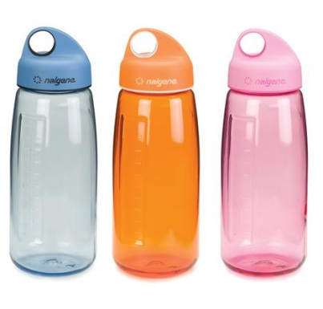
Bisphenol A (BPA)
Overview
Primarily used in polycarbonate plastic as well as epoxy resins and polysulfone materials
Used in baby bottles and water bottles for decades
Also used in coatings on the inside of almost all food and beverage cans
FDA ban on use of PC in infant bottles/spill proof cups

Slide 34

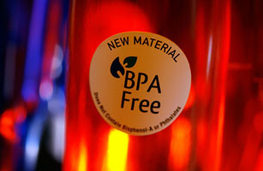
Wisconsin
  Bisphenol-A (BPA) is banned in baby bottles and sippy cups (<3 yrs.);
  Children’s items must be labeled “BPA-Free”;
BPA:
Suspected as an endocrine disruptor; risk to infants and young children;
Also may be present in epoxy resin coatings in cans and aluminum water bottles;
BPA also banned in 10 other states; mostly in baby bottles and sippy cups: CA, CT, DE, ME, MD, MA, MN, NY, WA, and VT; labeling not required;
Legislation pending in other states.

Slide 35


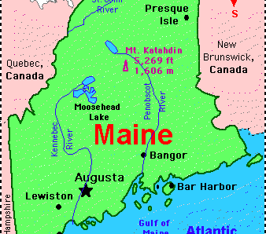

States with bans on certain kinds of flame retardants:
TRIS, TDCPP, TDCP, TCEP,TCPP, PBDEs, decaBDE, and others;
Found mainly in children’s clothing and furniture due to potential cancer risk through skin absorption or mouthing;
Connecticut, Delaware, Illinois, Massachusetts, Maryland, Maine, Missouri, North Carolina, New Jersey, New York, Oregon, Vermont, Washington…

Slide 36

Stuffed Toy Labeling
Massachusetts, Ohio, Pennsylvania
Stuffed toys and dolls for the states of PA, MA and OH must conform with the stuffed toy licensing and labeling laws
Manufacturers must register and pay fees must be paid to each state

Slide 37
Stuffed Toy Labeling
Manufacturers must submit detailed information about the filler content of the toy
Specimens of each toy selected at random
Uniform sewn in label to comply with all three states must contain:
    PA license number of manufacturer or vendor
    Name and principal place of business of the manufacturer or vendor
    Statement that “all new materials” (with type of material)

Slide 38


Rhode Island Jewelry Legislation
First state to adopt ASTM F2923-11 as mandatory
Children’s jewelry manufactured after December 18, 2012 must conform to the requirements of ASTM standard F2923-11, Specification for Consumer Product Safety for Children’s Jewelry

Slide 39
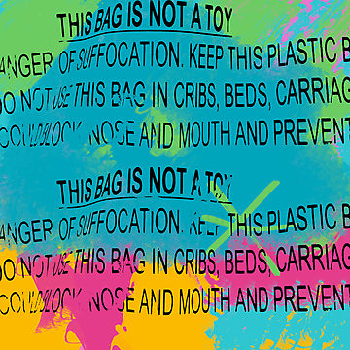
Polybag suffocation warning
Warning Label on Plastic Bags:
If polybag is less than 1 mil thick;
Opening is more than 5” wide at top;
Should be trilingual; English, Spanish and French (for Canada);
Required in CA, MA, NY, RI, VA

Slide 40
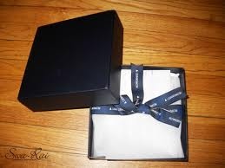
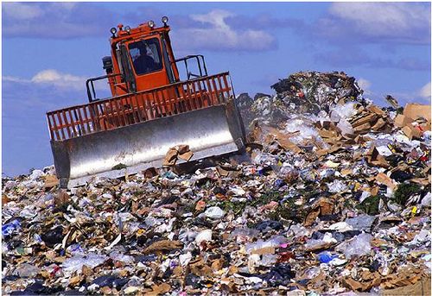
NERC Toxics in Packaging
(Northeast Recycling Council)
Intent is to reduce the amount of 4 heavy metals in packaging materials: lead, mercury, cadmium and chromium-6.
Reducing the heavy metals will reduce the amount that leaches from landfills into underground water and streams.
Should test packaging materials for compliance or obtain documentation; currently 19 states are part of NERC alliance.

Slide 41
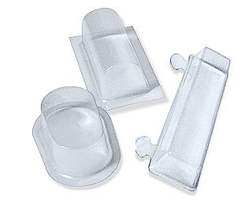
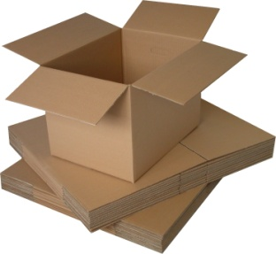
NERC Toxins in Packaging
What are packaging materials?
Master shipping cartons
Individual product packaging (gift box, plastic bag, header card, blister pack etc.)
Components used on shipping cartons (glue, tape, inks, staples, stickers etc.)

Slide 42
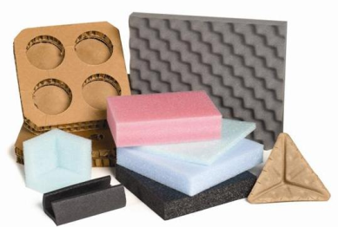
NERC Toxins in Packaging
Who is responsible?
Manufacturers of packaging and packaging components
Suppliers of packaging and packaging components
Product manufacturers or distributors who use packaging

Slide 43

Restriction of Hazardous Substances
California, Minnesota and New Jersey have adopted RoHS requirements for Electronic Devices
EN 1122 and EN 62321 method

Slide 44

Drawstrings in children’s clothing
CPSC Final Rule on Drawstrings became effective in 2011, but CPSC has considered drawstrings in children’s outerwear to be a substantial product hazard for years. Several CPSC recalls per year.
New York and Wisconsin have specific requirements, banning hood and neck drawstrings on all children’s clothing, but with limited exceptions for waist of upper and lower clothing drawstrings.

Slide 45
State Requirements
Hood and Neck Drawstring and Ties
 | New York Law | Wisconsin Law | 16 CFR 1120
Type of Apparel | All children’s clothing | All children’s clothing | Upper outerwear
Sizes | 2T-12 | 0-16 | 2T-12
Requirements | No hood or neck drawstrings allowed | No hood or neck drawstrings allowed | Drawstrings and ties cannot be used in the head or neck area

Slide 46
State Requirements
Waist of Upper and Lower Clothing Drawstring
 | New York Law | Wisconsin Law | 16 CFR 1120
Type of Apparel | Children’s upper and lower clothing | Children’s upper outerwear | Children’s upper outerwear
Sizes | 2T-16 | 0-16 | 2T-16
Requirements | No toggles, knots or other attachments The drawstring must be attached to the garment’s midpoint 3 inch rule | No toggles, knots or other attachments The drawstring must be sewn at the midpoint of the channel, so it cannot be pulled out of the channel 3 inch rule | No toggles, knots or other attachments The drawstring must be sewn at the midpoint of the channel, so it cannot be pulled out of the channel 3 inch rule

Slide 47

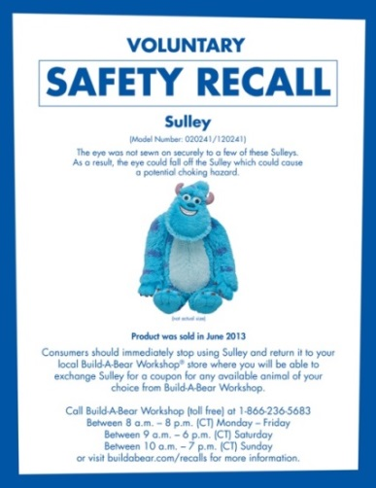


How can these regulations affect my company?
Violations can be costly, damage a company’s brand, and establish a “prior offense”
that will can result in higher fines and penalties in the future.
Product safety and compliance problems can damage relationships with clients and brand partners.
Safety recalls may result; are very expensive and will damage a company’s brand.
Claims and suits arise often. May result in greater gov’t scrutiny.
A good compliance track-record builds equity with customers, the supply chain, investors and regulators.

Slide 48
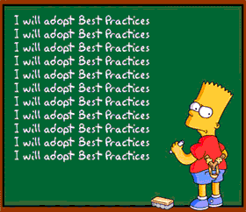
What can I do for my company?
Adopt Best Practices:
Source from only trustworthy and knowledgeable vendors;
Develop company requirements and standards for compliance;
Educate your vendors of your requirements;
Require written verification of compliance with state and federal regulations;
Take other steps to make your company a “hard target”.

Slide 49

Questions?

Slide 50
Resources
PPAI: www.ppai.org
Cal Prop 65: http://oehha.ca.gov/
CA Safer Consumer Products Program: http://www.dtsc.ca.gov/SCP/index.cfm
WA Children’s Safe Products: http://www.ecy.wa.gov/programs/swfa/cspa/
Illinois Lead Poisoning Prevention Act: http://www.ilga.gov/legislation/ilcs/ilcs3.asp?ActID=1523&ChapterID=35
U.S. Consumer Product Safety Commission: www.cpsc.gov; www.saferproducts.gov; www.recalls.gov
UL Consumer Products: http://www.ul.com/global/por/pages/businesses/verificationservices/businesssegments/consumerproducts/
Questions?
  Anne Lardner-Stone at PPAI: AnneL@ppai.org
  Tim Brown at PPAI: TimB@ppai.org

